Slide 1

MECH 652/MECH 447 Dynamics of Combustion
Implementation of Jet C1/Hydrogen Blends in an Aircraft Gas Turbine Propulsion System
Group 3

Slide 2

Overview
Alternative Fuel and Simulation Setup
Preliminary Calculations
Alternative Fuel properties
Modern gas turbine concepts
Results
Feasibility and Aircraft design impacts
Conclusion

Slide 3
Simulation Setup| Mechanism
Fuel: Jet C1/ Hydrogen blends
Mechanism
Selected Mechanism – Jet C1 fuel (by HyChem modelling group, 66 species Skeletal Mechanism (Detailed C1 Mech + NOx captured by 150 species Glarborg's mechanism))
Combustion System: Gas Turbine
Objective – Reduce emissions
Design variables – Blending ratio, Equivalence ratio
Constraints – Power, Air mass flow rate

Slide 4
Preliminary Calculations
Fixed Power output - 100 MW
Combustion Efficiency - 50 %
Mass flow rate - 50 kg/sec
Calorific value (Q) - Weighted mass averaged (C1 and H2)
Cases | Pure C1 | 10 % H2 | 20 % H2 | 30 % H2
Eq. ratio | 1.4 | 1.26 | 1.17 | 1.11

Slide 5
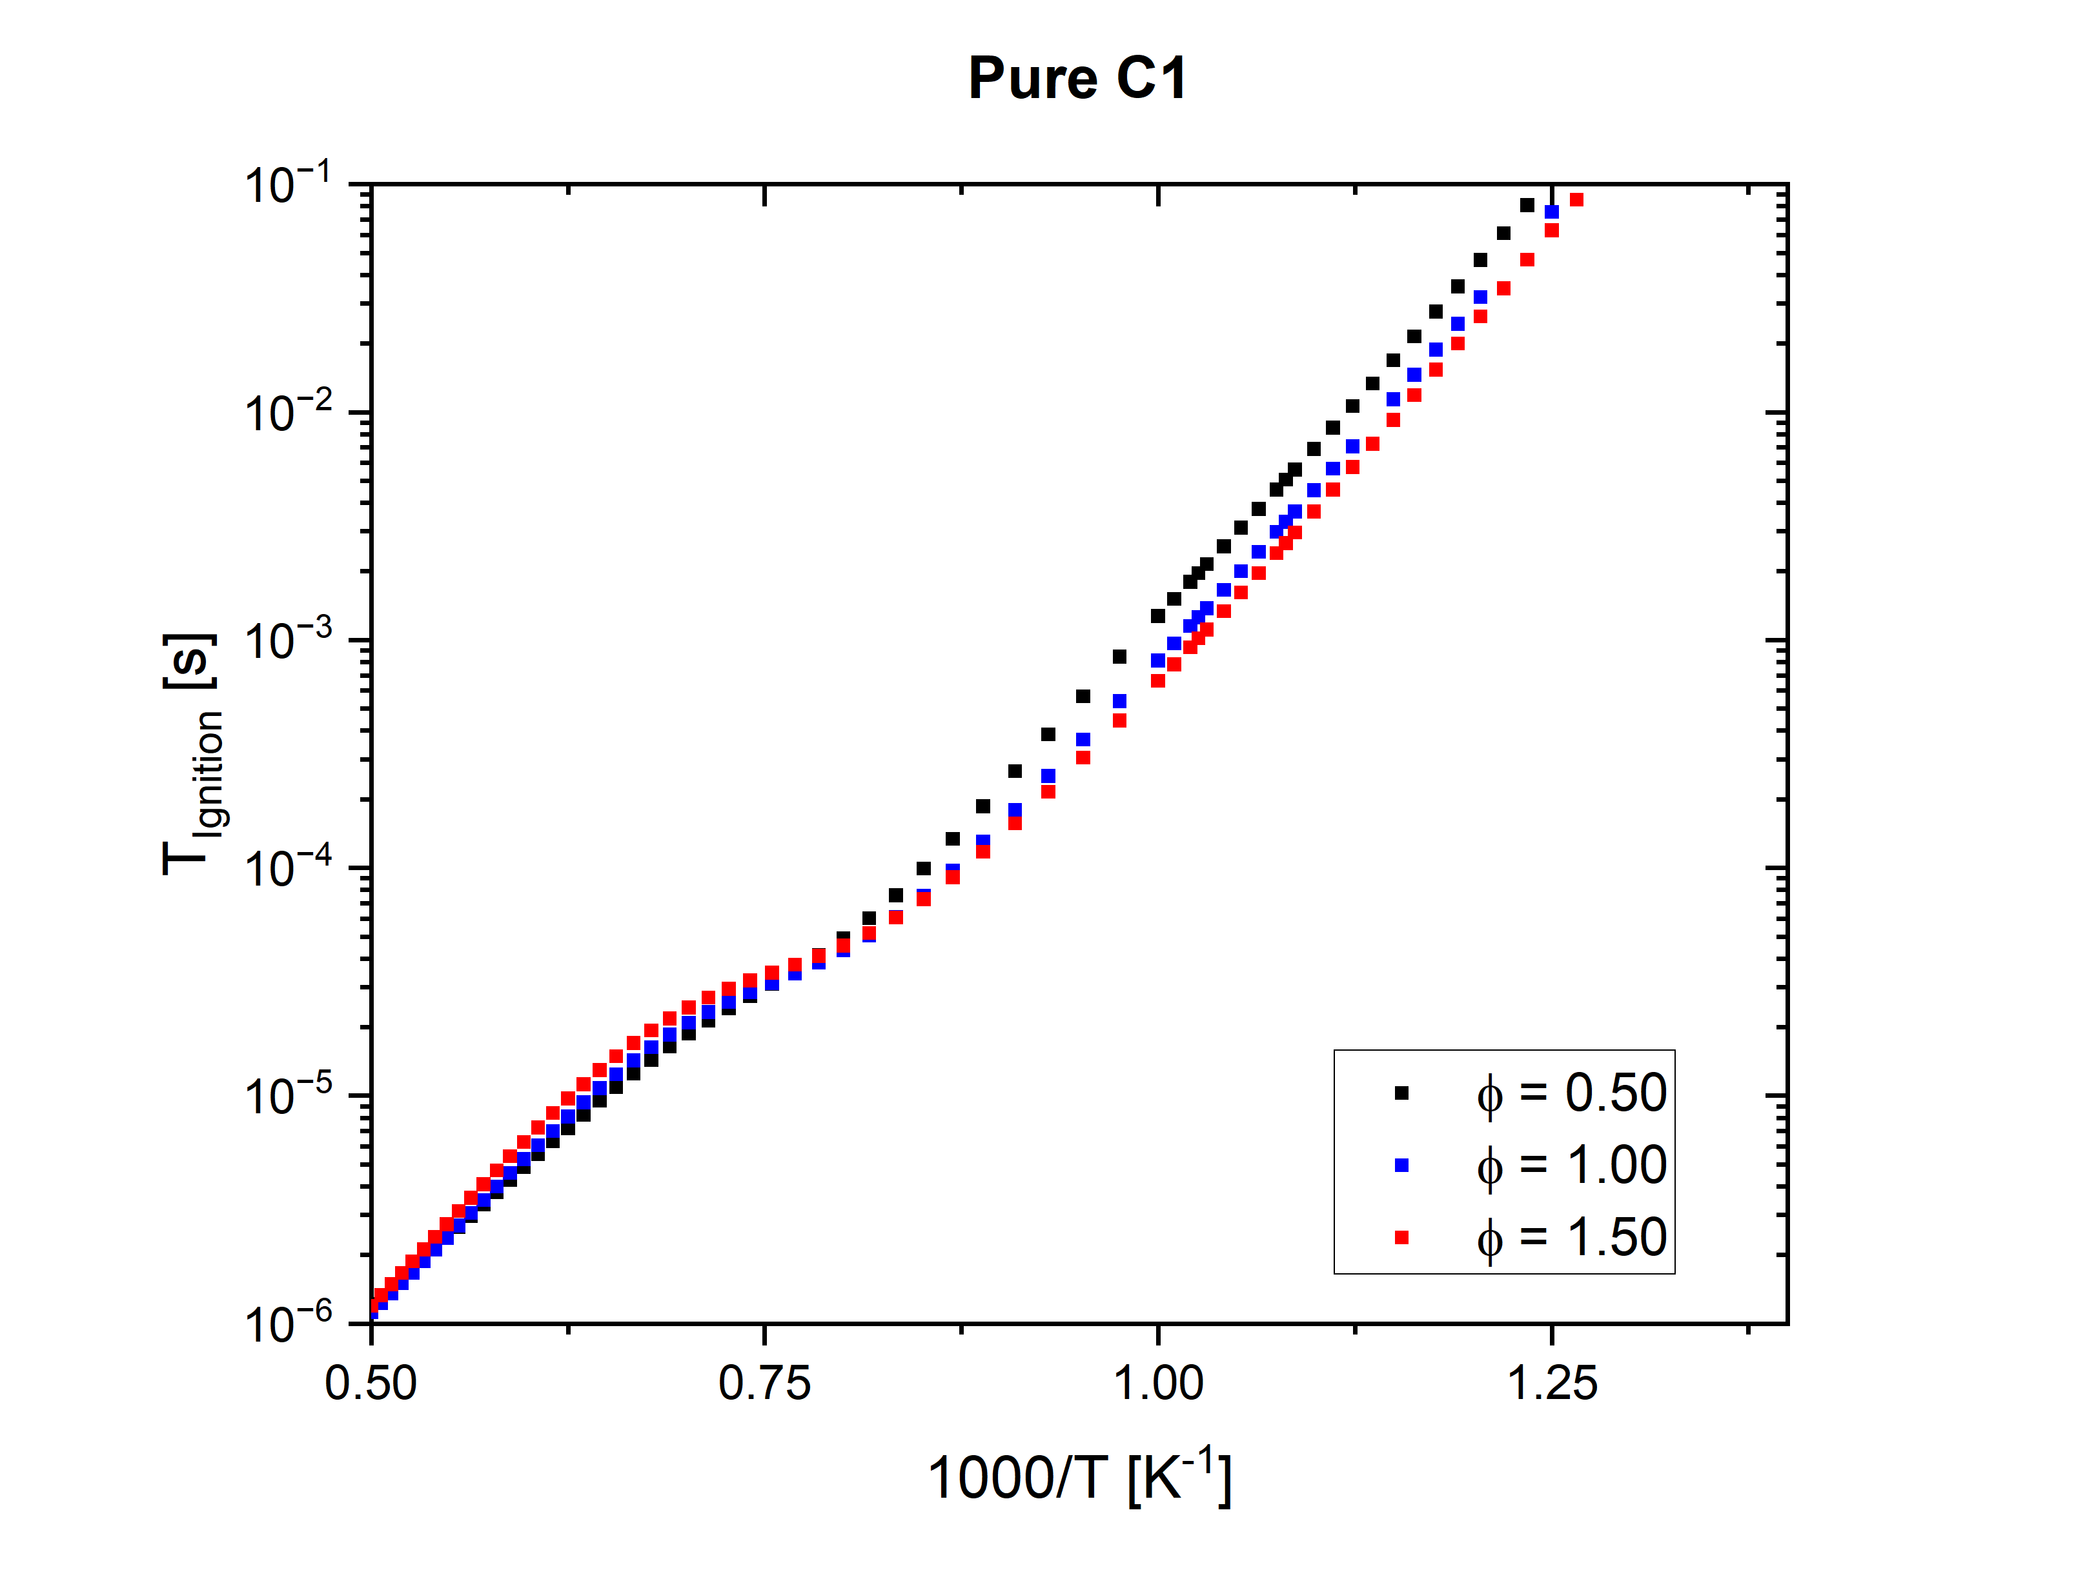
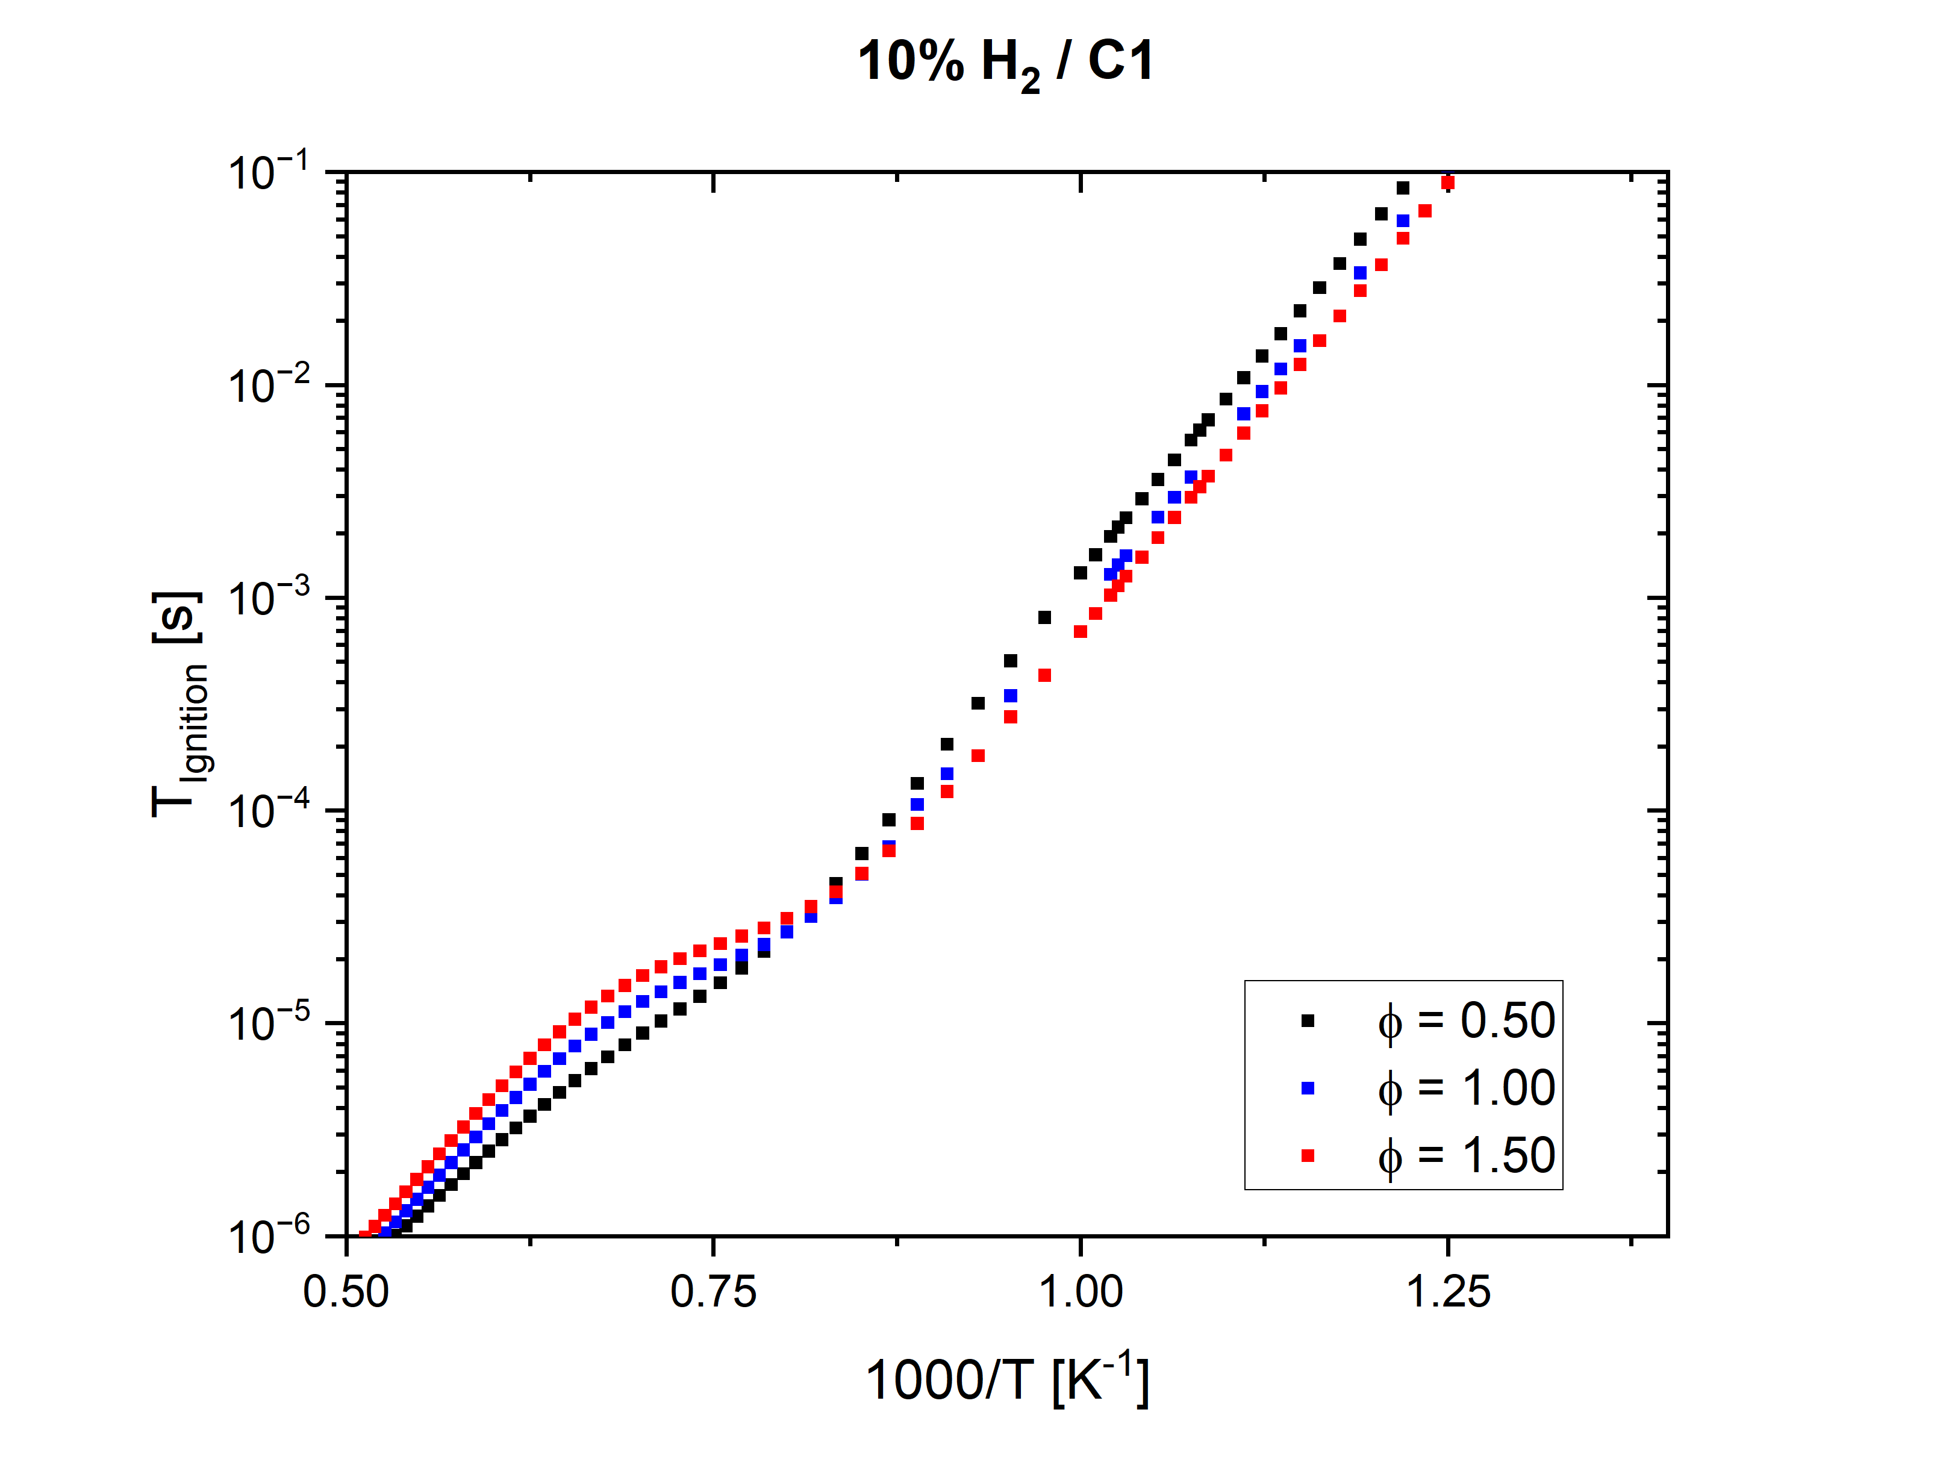
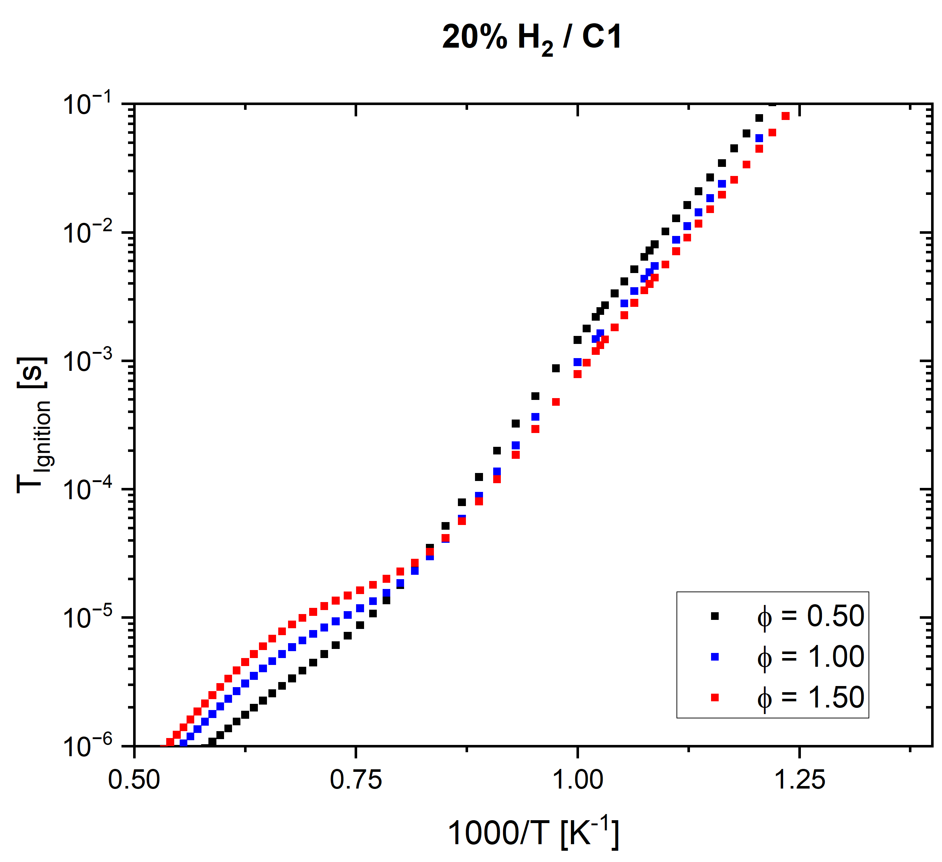
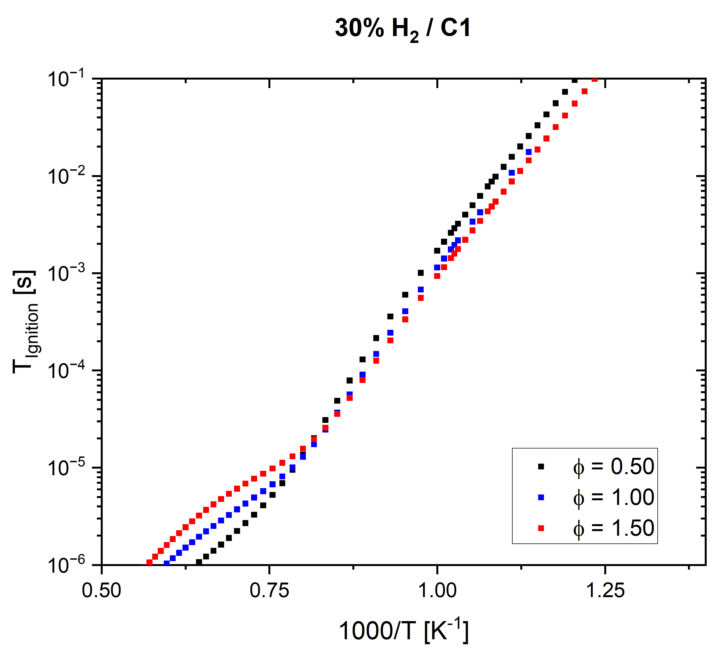
Results of Ignition Delay with Jet C1/Hydrogen Blends
Decrease in ignition delays allows us to make our chamber length short which results in small combustor.
Pure C1 : At high temperature region increase in phi leads to increase in ignition delays whereas for lower temp entire case reverse.
Blends : Increase in hydrogen concentration tends to follow same pattern but over all ignition delay decreases as it allows to burn mixture faster than pure C1 fuel.
No NTC behavior (Present mech.)

Slide 6
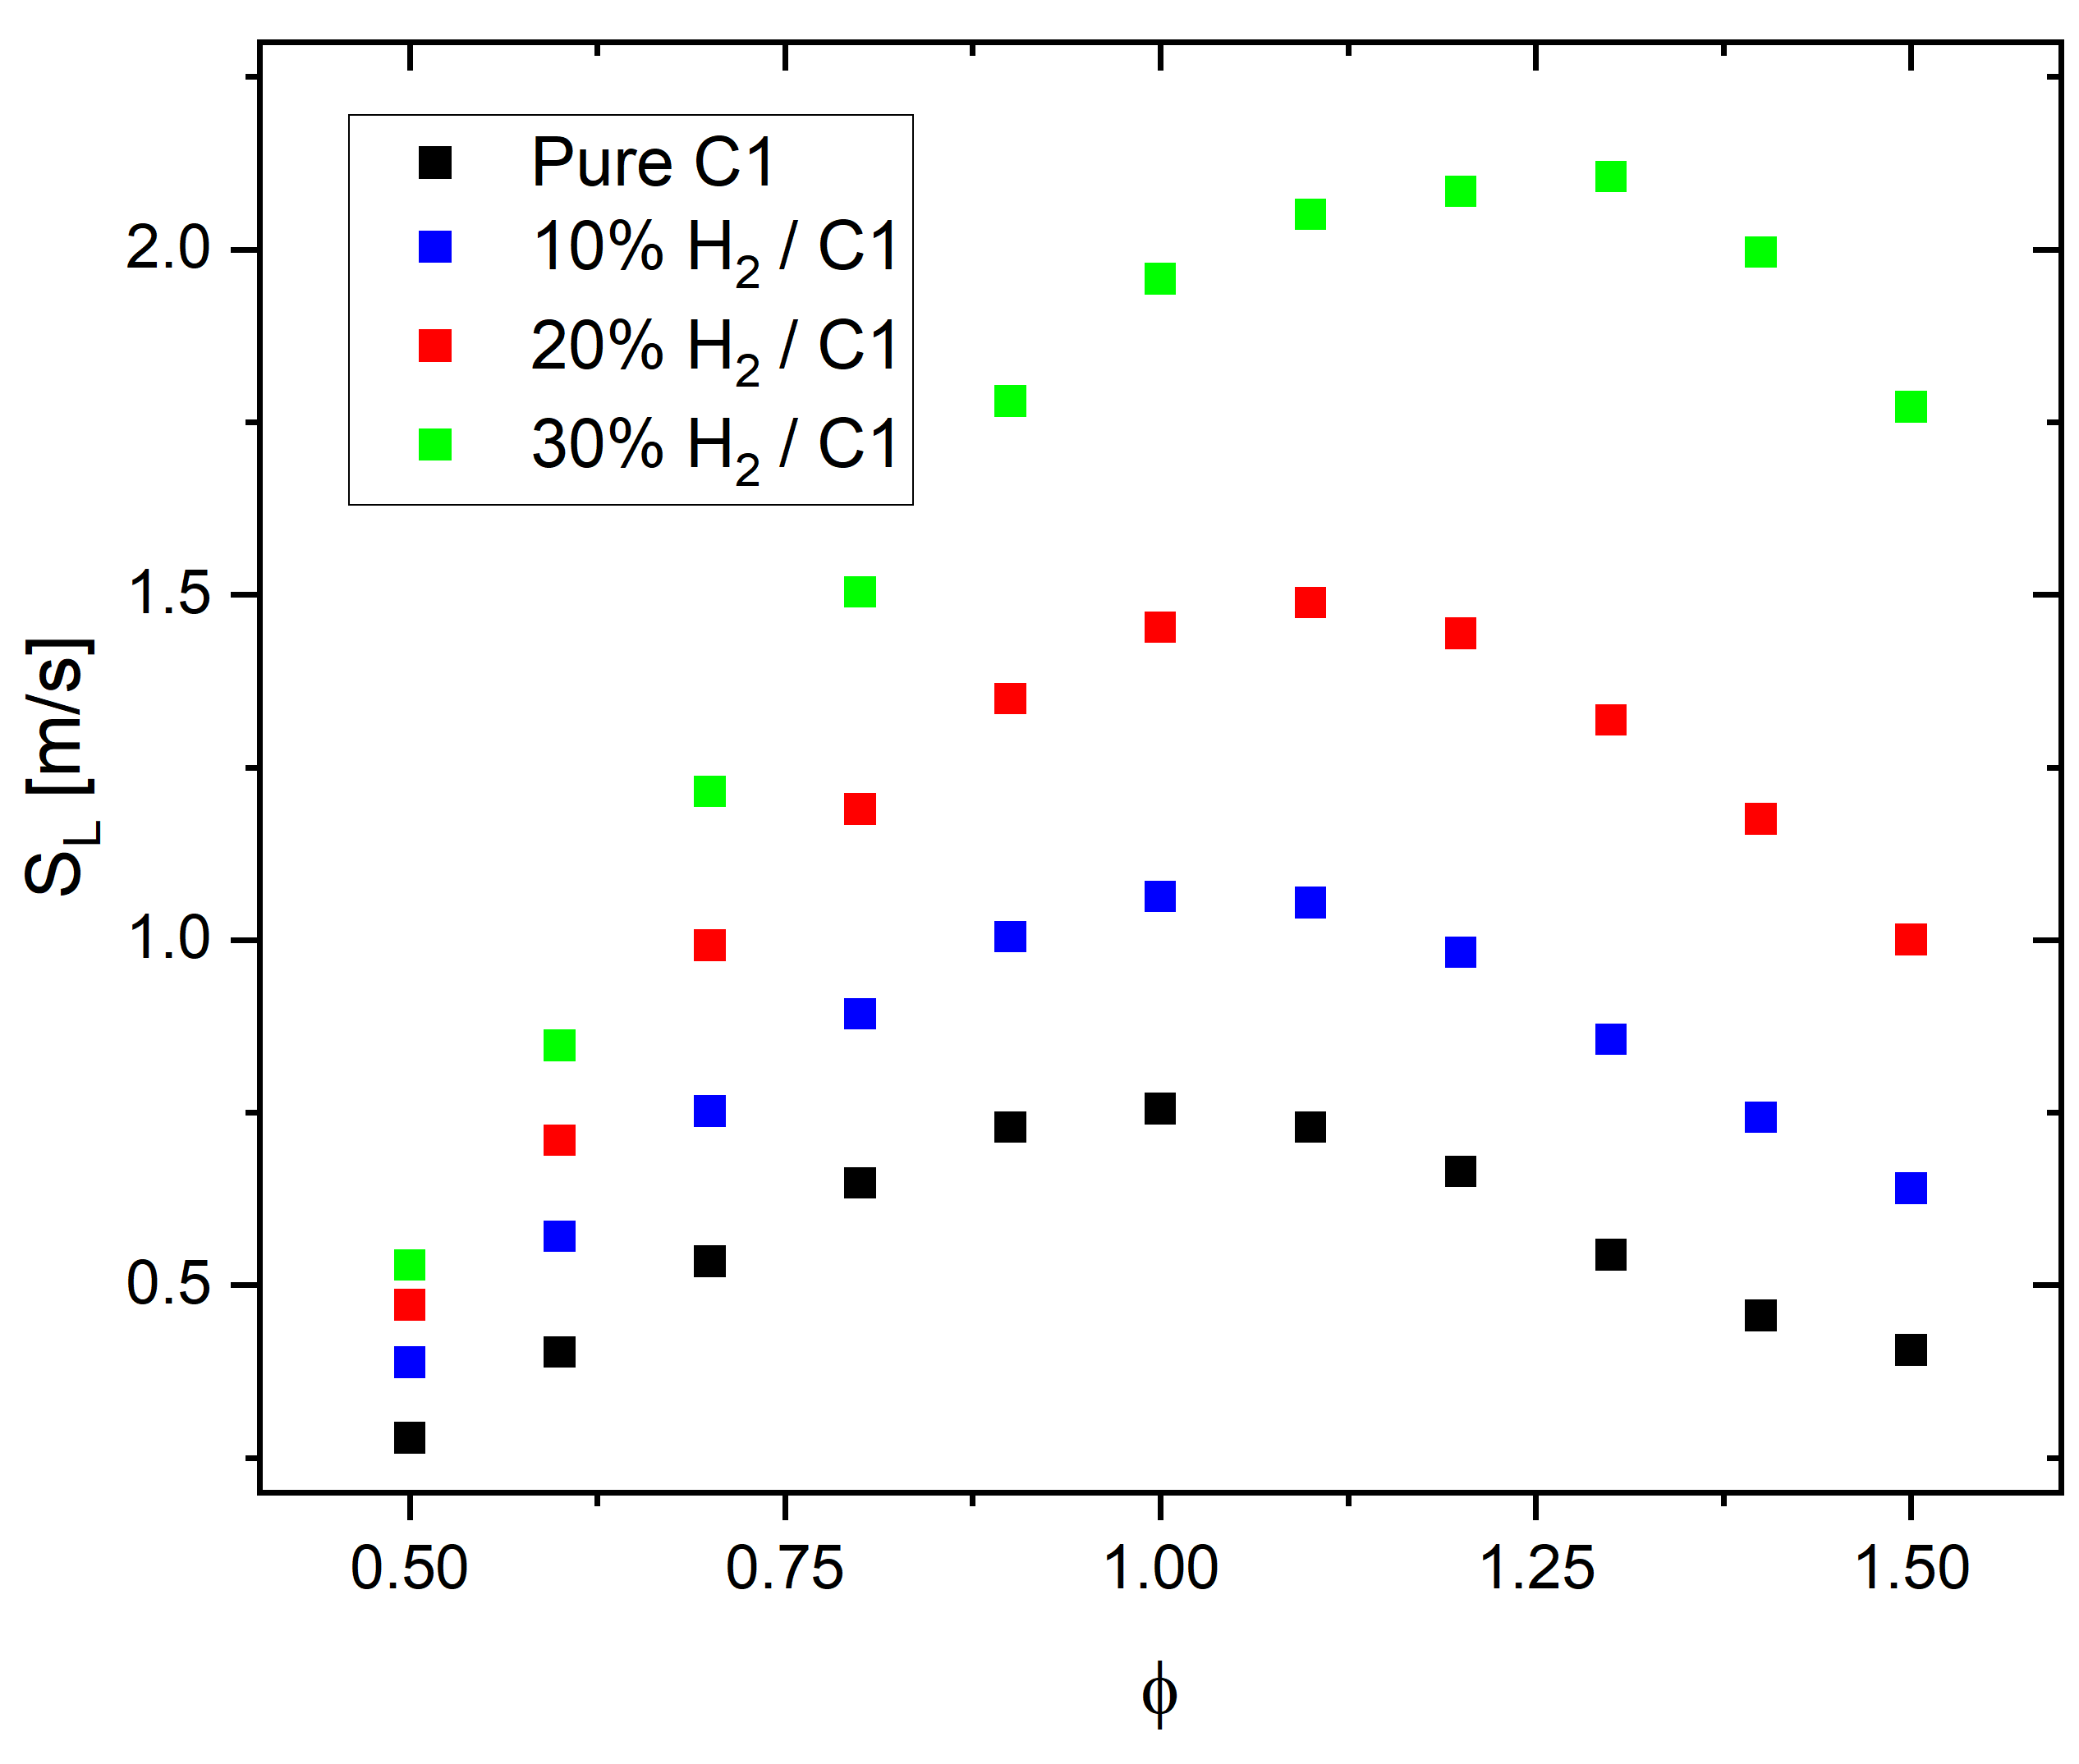
Laminar Flame Velocity
Increases in flame speed
Increases with the pressure in the combustor
Can increase the possibility of a flash back (In Case of Premixed)
Can lead to shock waves and even detonation
Flame stability
Figure 2 – Laminar flame velocity vs equivalence ratio

Slide 7
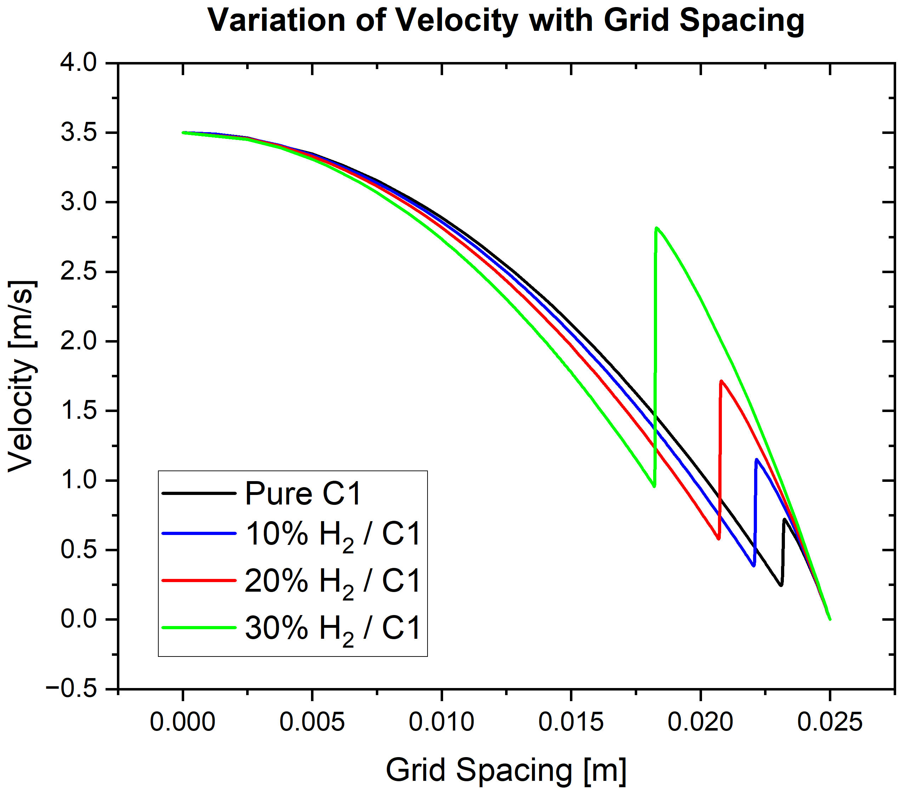
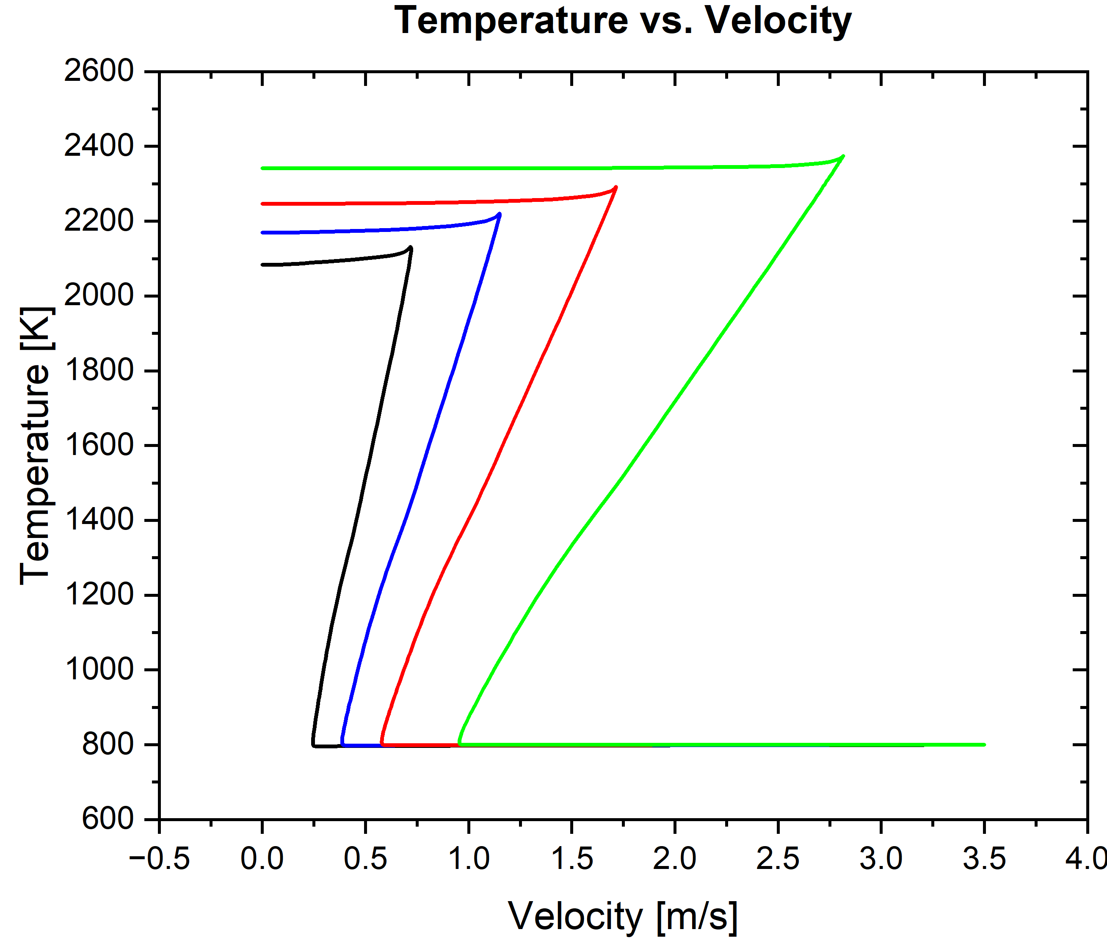
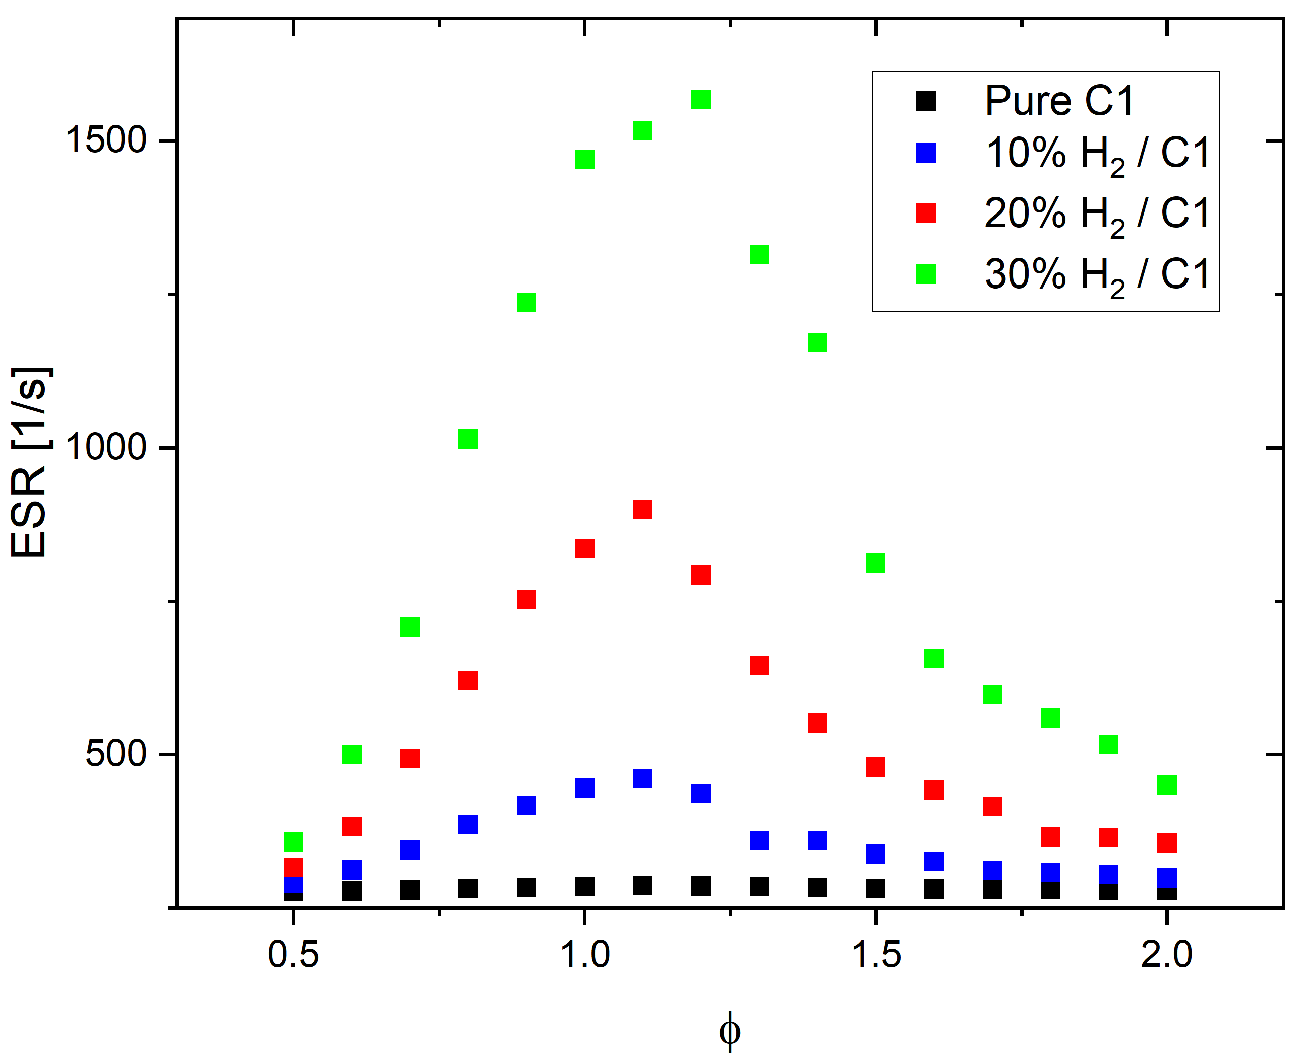
Extinction Strain Rates
Counterflow premixed configuration – 800 K, Jet C1/H2/air flames
Flame stretch rate increases as blending ratio is increased.
Extinction limit – du/dx is maximum

Slide 8
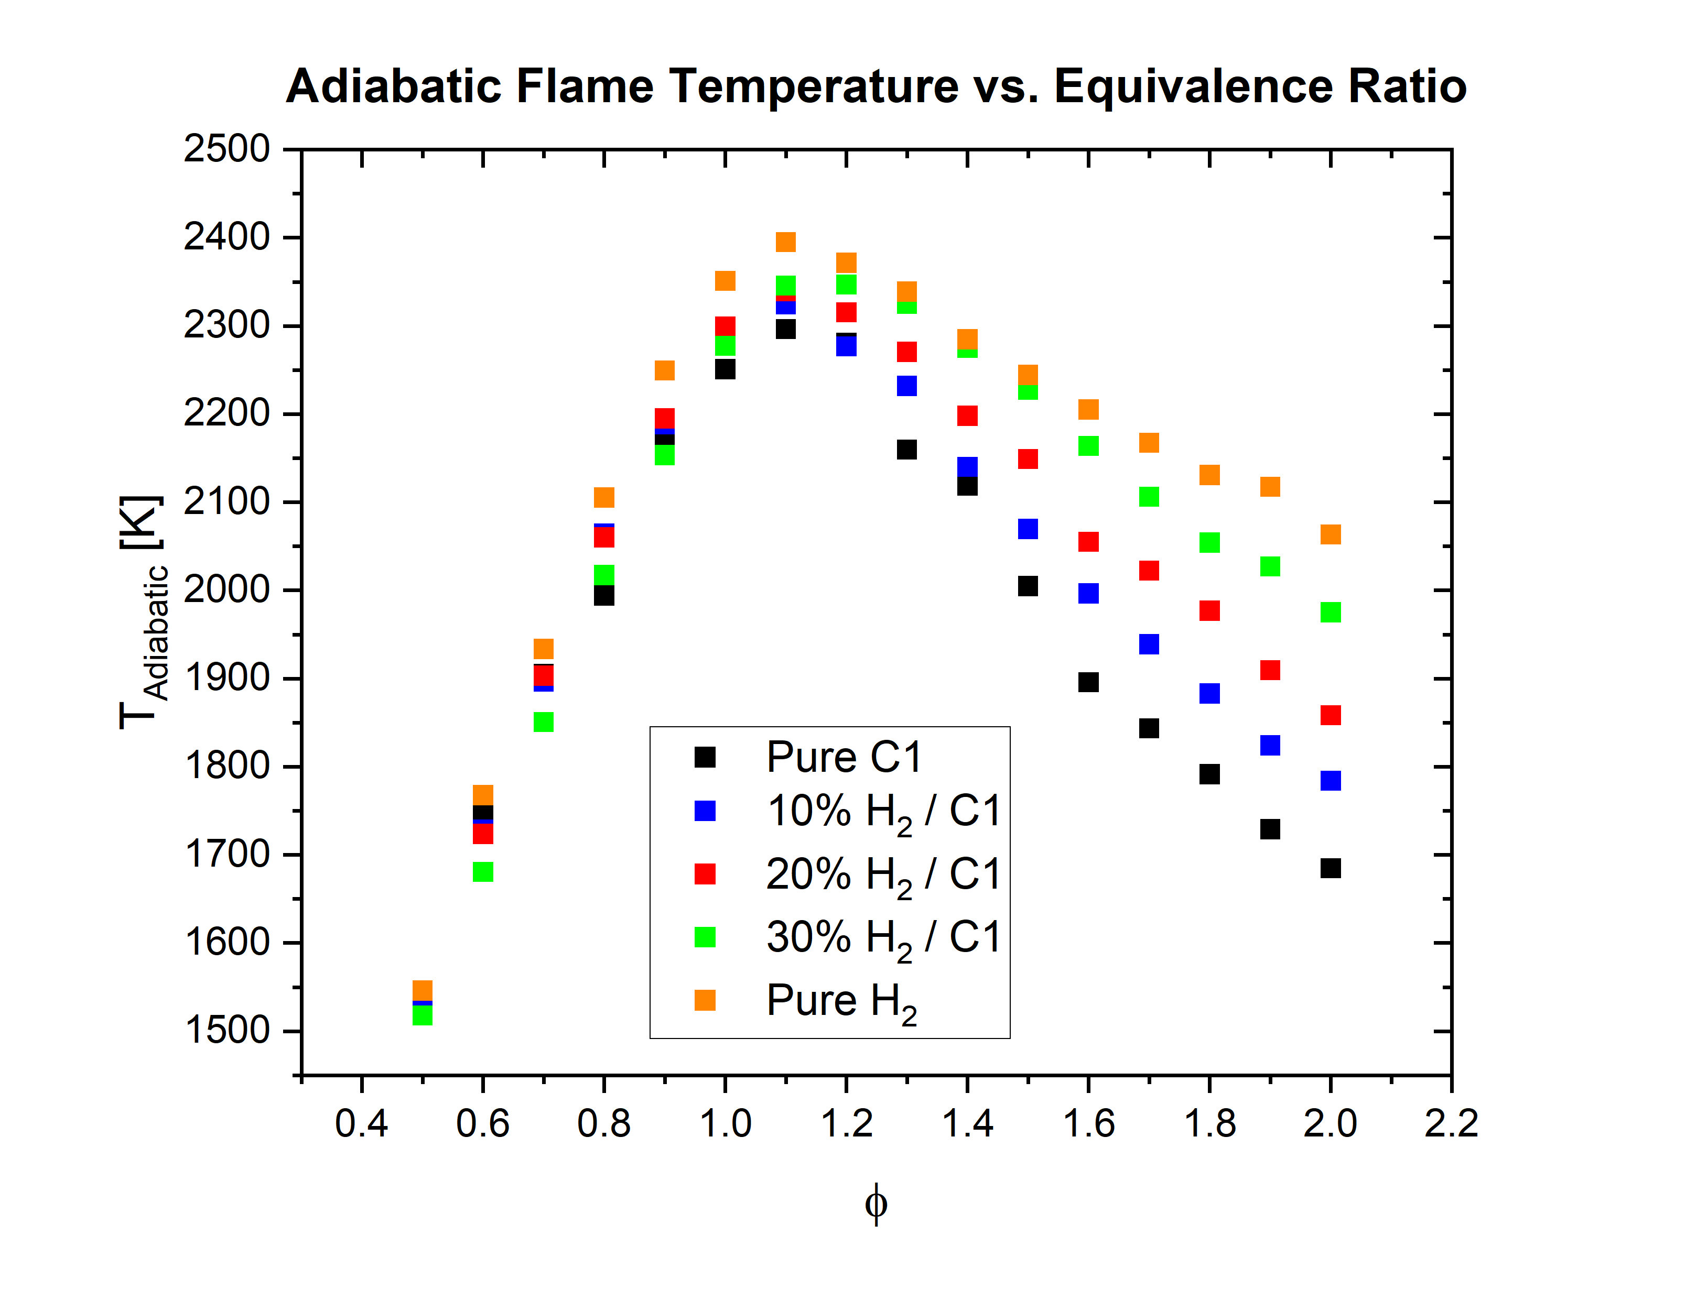
Adiabatic Flame Temperature
NOx formation increases
Implementation of emission control techniques
Figure 3 – Adiabatic flame temperature vs equivalence ratio

Slide 9

Modern Gas Turbine Emission Control Techniques
EGR – Exhaust Gas Re-circulation
DLE – Dry Low Emissions
MILD – Moderate or Intense Low Oxygen Dilution
RQL – Rich Burn; Quick Quench Lean
State of the art, LEAP 1B in the 737 max
Can be used for a wide range of fuels with minimal modification to the system
Felt like a good challenge!

Slide 10
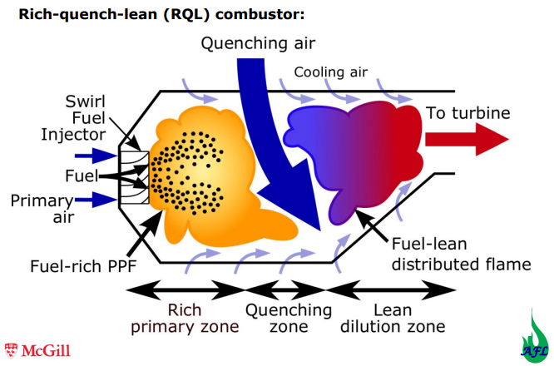
RQL | Benefits and Challenges
Benefits :–
Emission reduction – Ideally, we avoid stoichiometric combustion
Fuel Flexibility
High combustor stability due to the rich primary zone
Challenges :–
Quick-Mix region
Best mixing in zone 2 may not necessarily reduce NOx emissions i.e. aerodynamically optimized mixer does not guarantee NOx reduction.
Combustor material (Presence of Nitrogen oxides and H2 embrittlement)
Source: Dynamics of Combustion-Lecture 8 (Prof. Jeffrey M. Bergthorson)
Lecture 8 Dynamics Of Combustion – Prof. Jeffrey M. Bergthorson
Notes:
Explanation of selection of combustor material - In the primary zone, for example, the use of air for cooling the liner wall is precluded in order to avoid the generation of near-stoichiometric mixture ratios and the associated production of nitrogen oxides in the vicinity of the wall. As a result, the temperature and composition of gases in the primary zone create a demanding, reducing environment for the liner material. The concentrations of hydrogen alone and the concomitant demands of hydrogen embrittlement in particular have combined to require a major investment in materials research in support of RQL technology.
Quick Mix - A key to the success of the RQL is the efficacy of mixing the air with the effluent exiting the primary zone. The mixing of the injected air takes the reaction through the conditions most vulnerable for the high production of oxides of nitrogen

Slide 11
RQL| Implementation - Cantera
Air Composition – 800 K, 30 atm, 79 % Nitrogen, 21 % Oxygen
Limited Fuel species
Air
Laminar Premixed Flame
Well Stirred
Reactor
Plug Flow Reactor
R
Q
L
{T, P, Y₁,Y_{2…..} Y_{N} }₁
{T, P, Y₁,Y_{2…..} Y_{N} }₂
Figure 6 – Cantera Setup
https://www.tandfonline.com/doi/epdf/10.1080/00102202.2020.1748018?needAccess=true

Slide 12
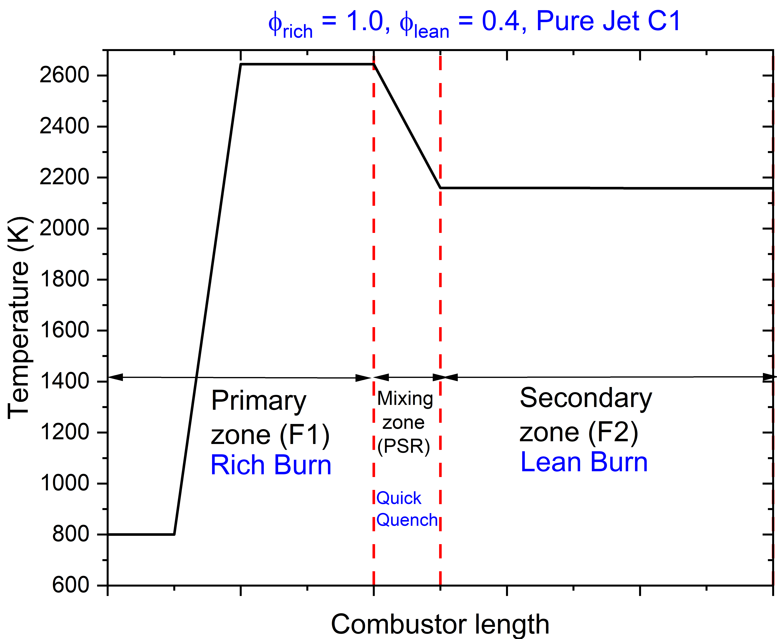
RQL| Test Case
Figure 7 –Temperature vs combustor length

Slide 13
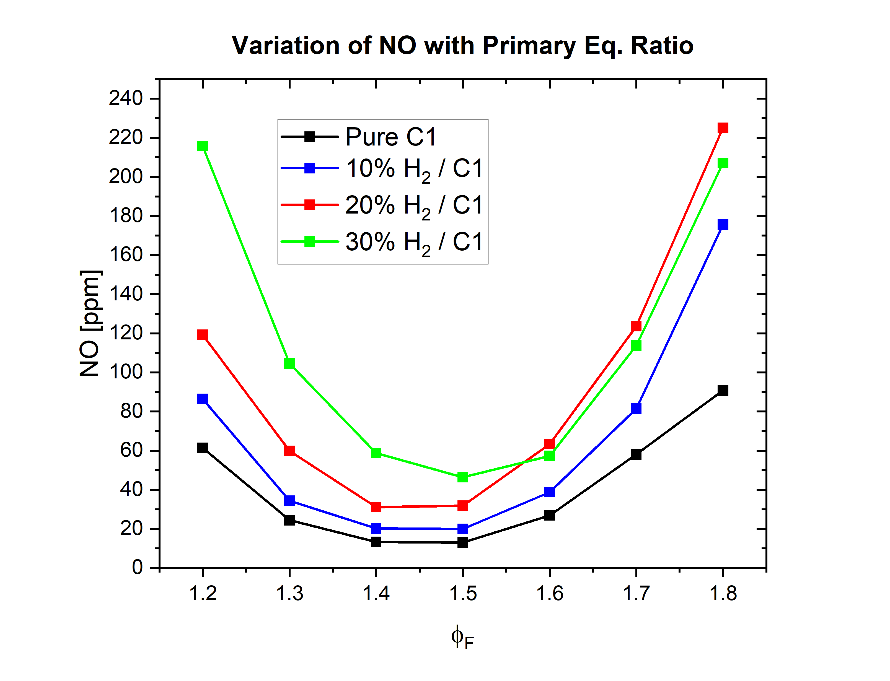
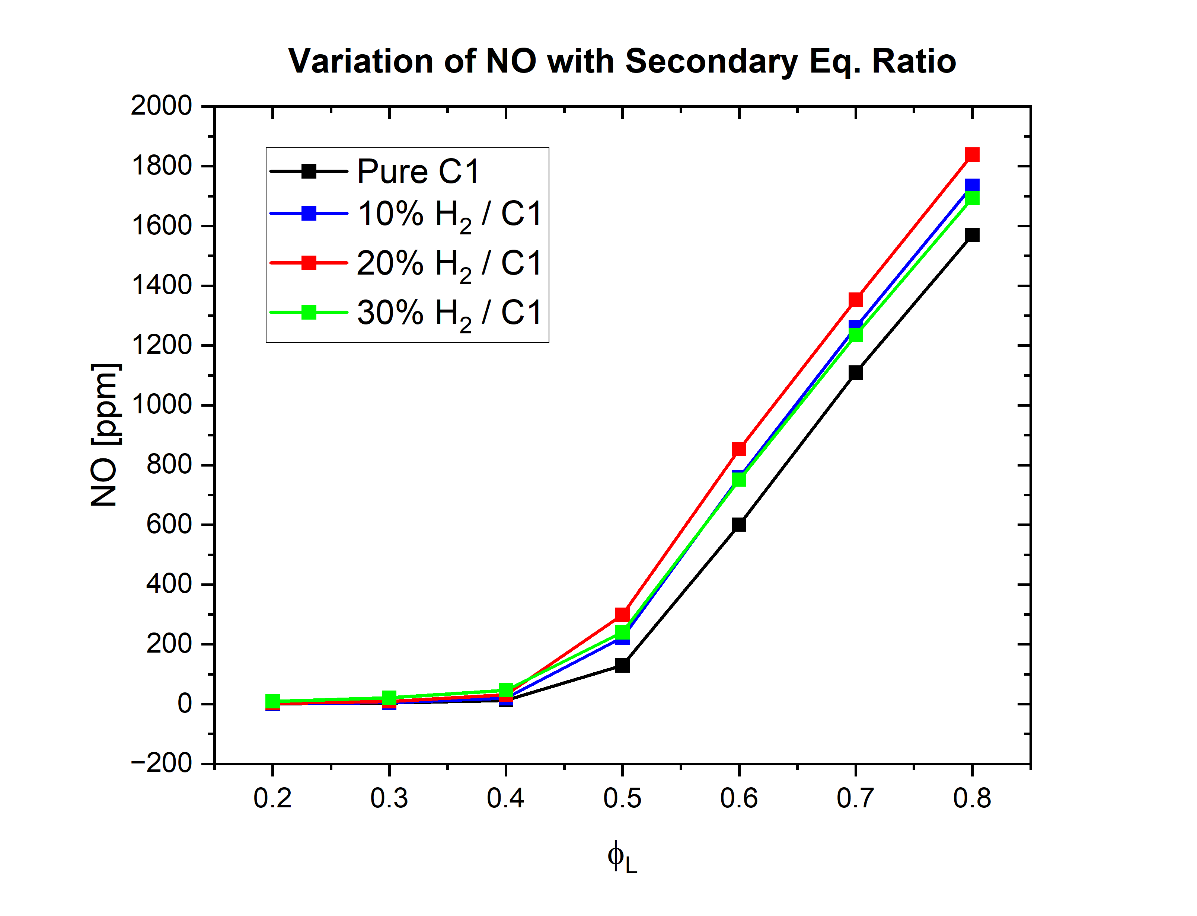
Emissions| NOx
NOx vs primary equivalence ratio (sec is fixed – 0.4)
NOx vs secondary equivalence ratio (primary is fixed – 1.5)

Slide 14
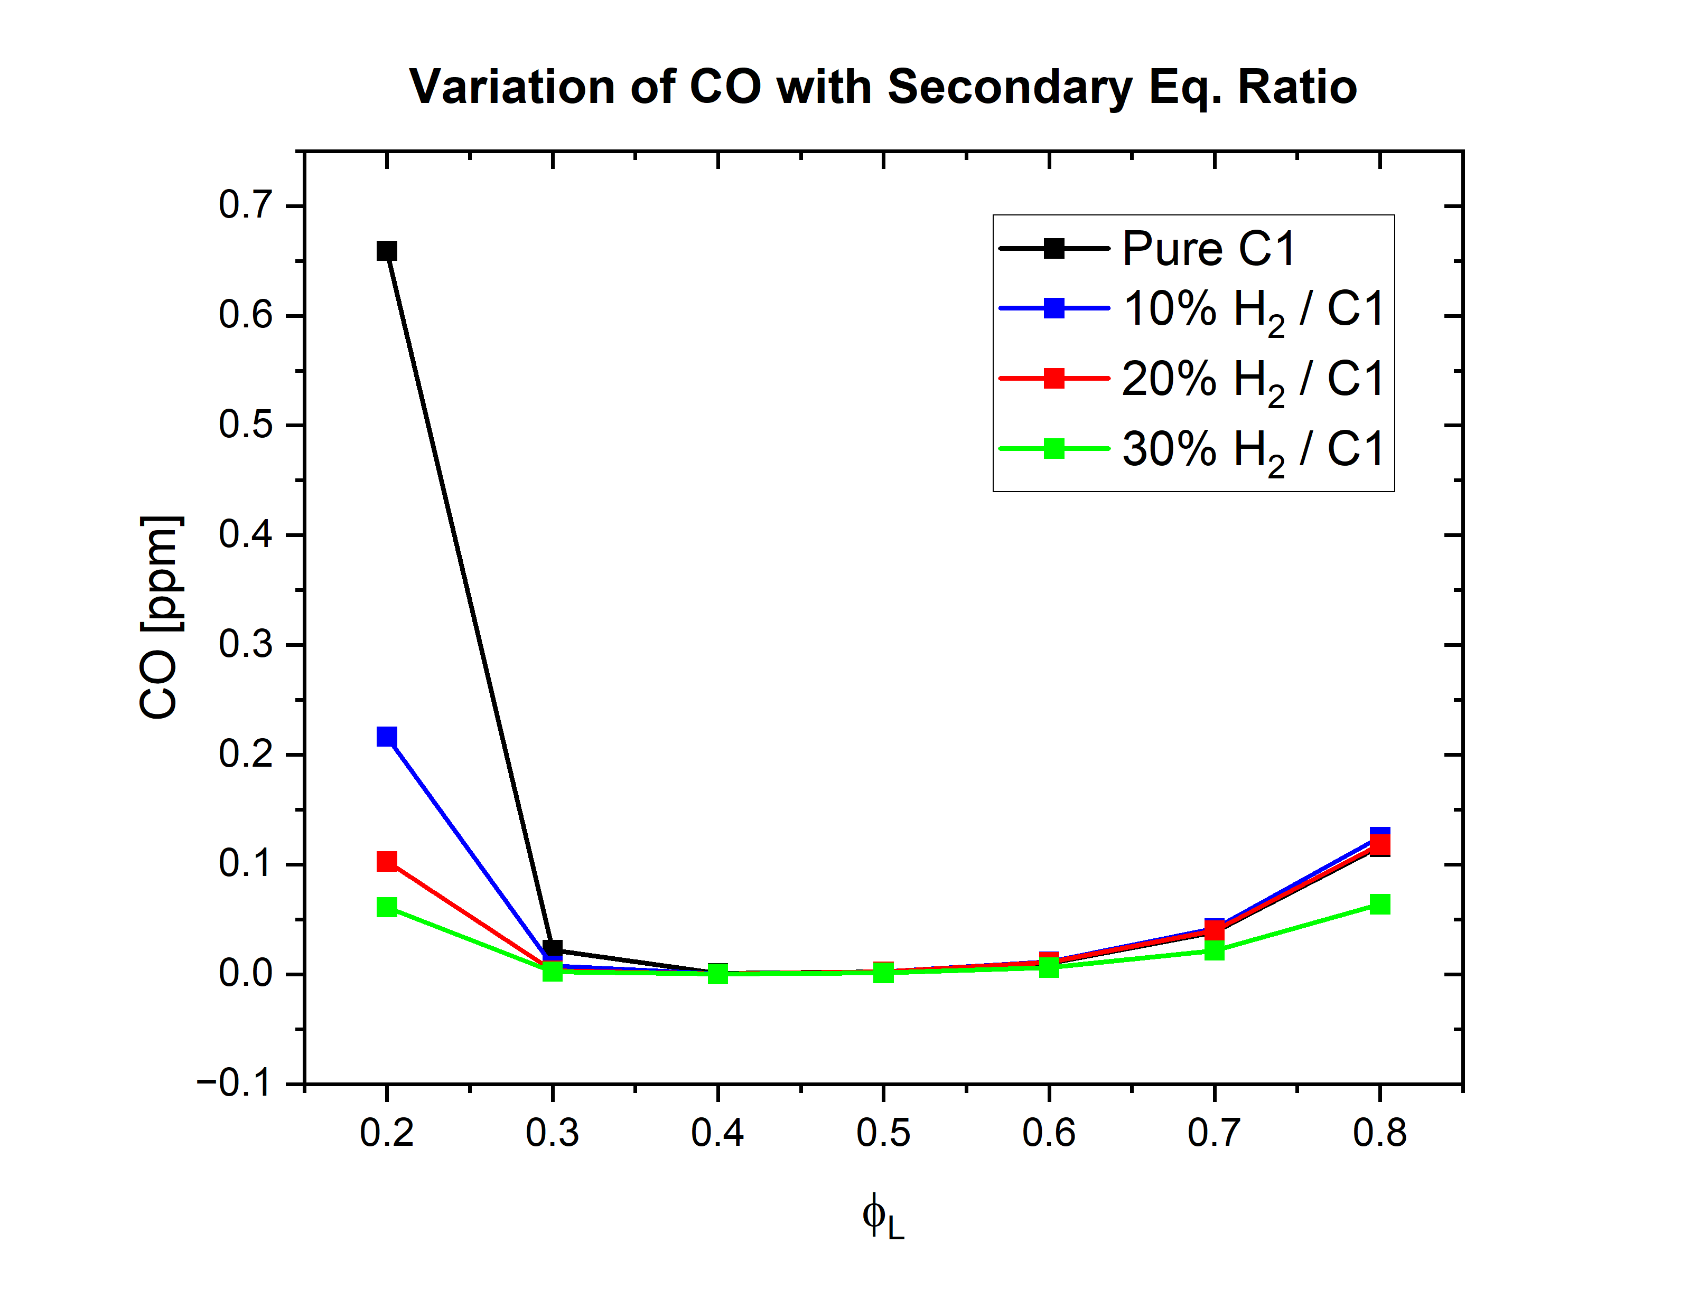
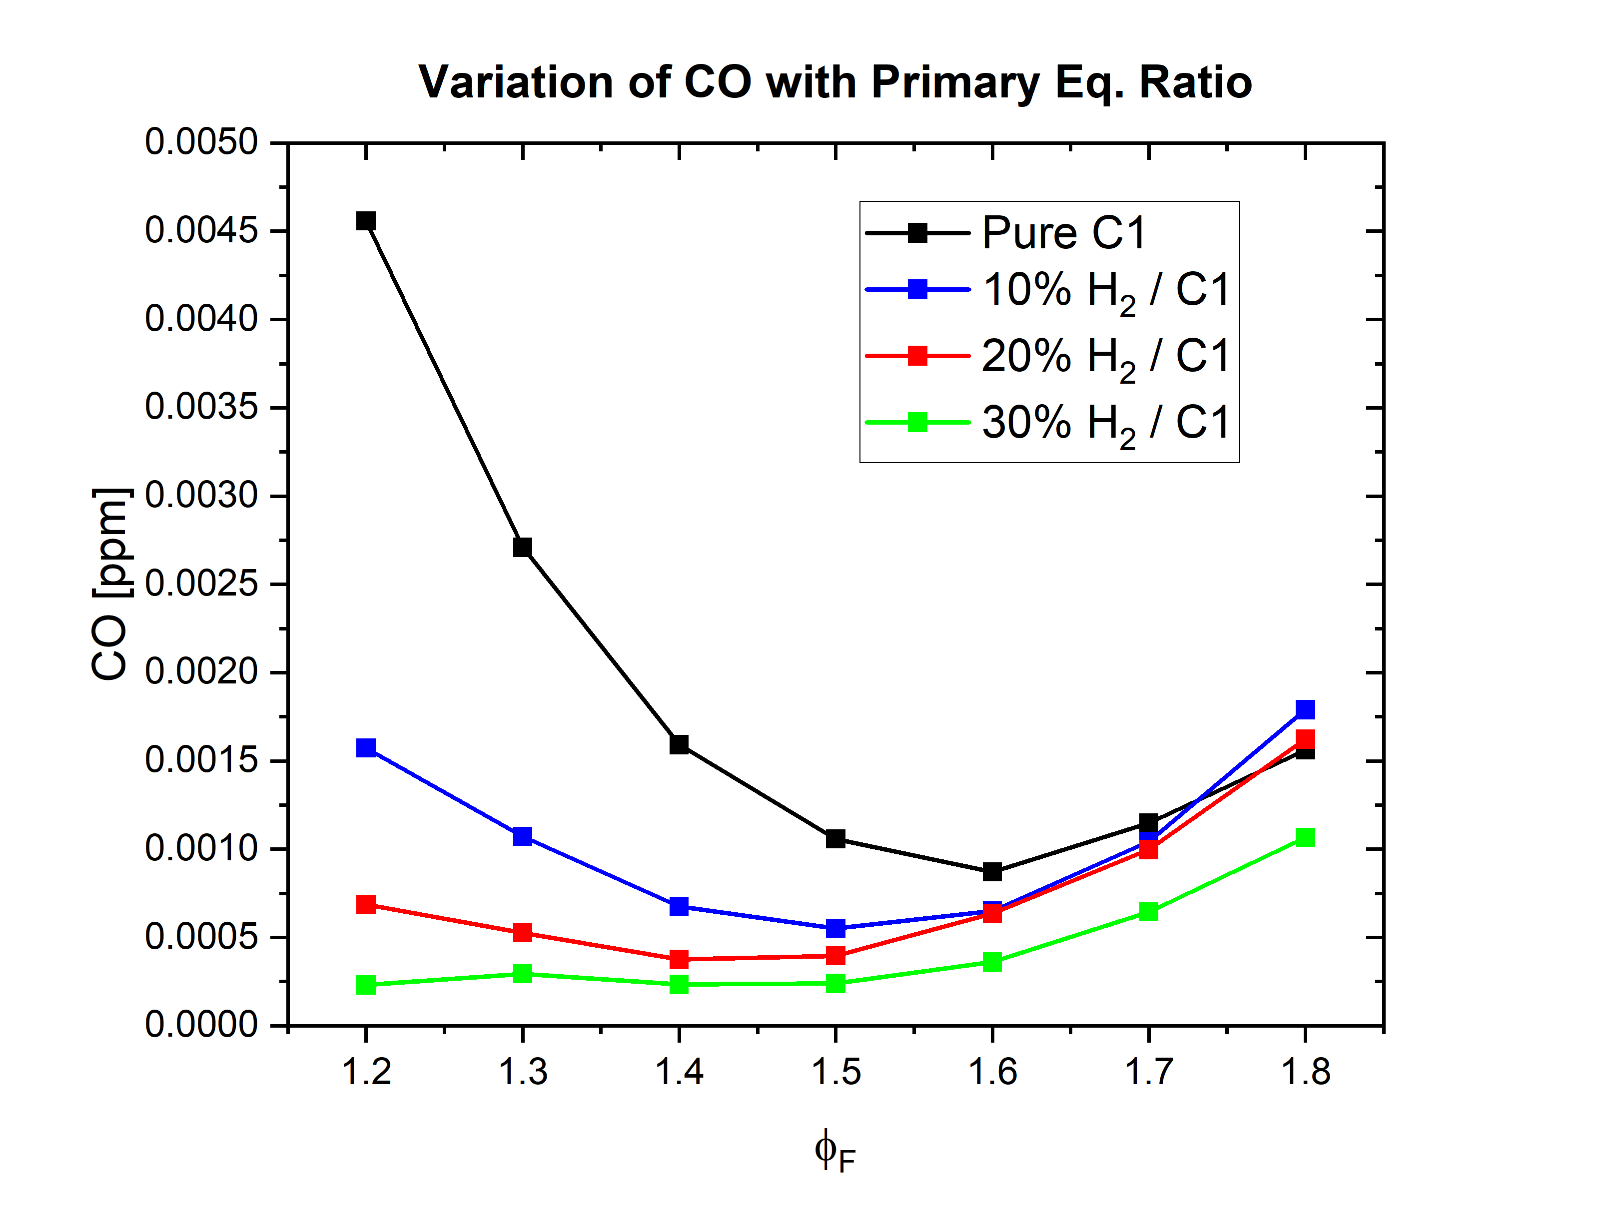
Emissions| CO
Figure 8 – CO vs secondary equivalence ratio
Figure 9 – CO vs primary equivalence ratio

Slide 15
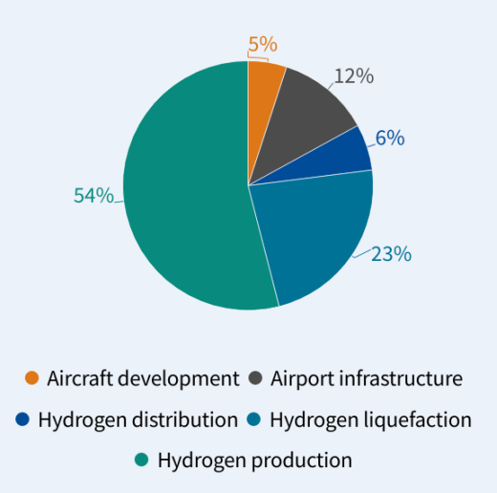
100% Hydrogen in aviation | Feasibility
For an aircraft with entry into service of 2035, with a 2000 nm range.
299 Billion Euros are needed between 2025 and 2050 to develop and run the hydrogen aviation value chain in Europe.
Most of the costs would be on the production and liquification of green hydrogen.
Costs associated with implementing hydrogen fuel in aviation
Source: Transport and Environment org
Transport and Environment . (2023). The cost of hydrogen aviation - making hydrogen aircraft cost competitive. Transport and Environment .
Notes:
, An analysis was conducted by the European Climate Foundation and the Transport and Environment into the cost of implementing Hydrogen in aviation.
They determined that 299 billion euros would be needed between 2025 and 2050 to develop and run the hydrogen aviation value chain in Europe.
Assuming for an aircraft that enters into service in 2035 with a 2000 nm range most of the cost would be for the production of hydrogen and the next for the liquification of Hydrogen. And we can see that any changes to the design of the aircraft would only account for 5% of the total cost.
One possible way of avoiding the costs associated with having 100% hydrogen would be to have blends with jet fuel.

Slide 16
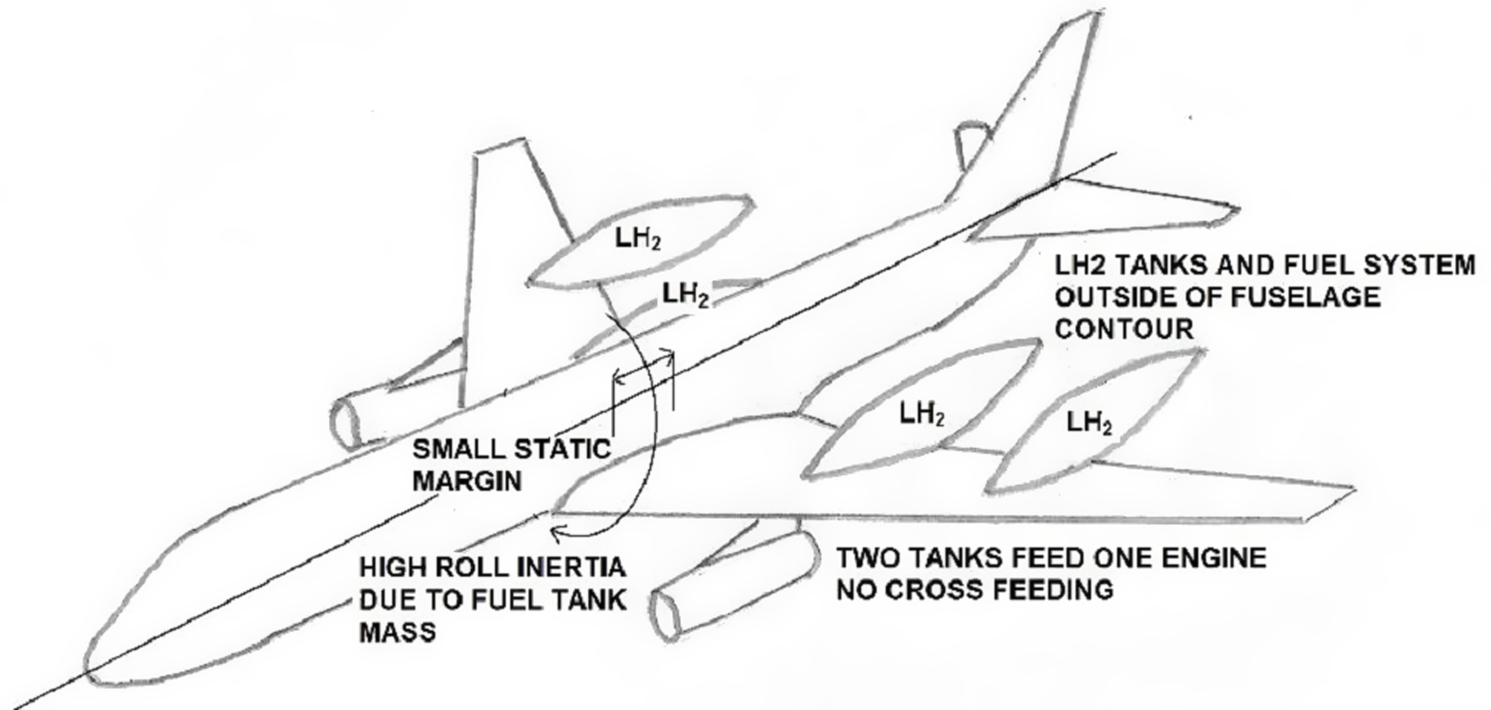
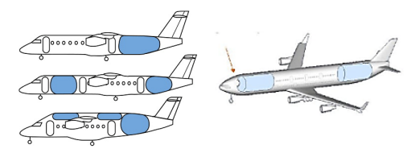
Aircraft Design| Impacts
Non-integral Fuel Tanks
Integral Fuel Tanks
Figure 13 – Illustration of non-integral fuel tanks
Figure 14 – Illustration of integral fuel tanks
External fuel tanks located on the airframe
Designed to sustain aerodynamic loads and must not contribute to drag.
Internal fuel tanks located in the fuselage
Designed to sustain structural loads
Will increase the length and width of the fuselage
Spencer, R. (2023). Certification considerations for the configuration of a hydrogen-fuelled aeroplane. The Aeronautical Journal, 127(1308), 213-231. doi:10.1017/aer.2022.79
Rondinelli, S, Sabatini, R and Gardi, A 2014, 'Challenges and benefits offered by liquid
hydrogen fuels in commercial aviation', in Meenakshi Arora, Geoff Sutherland, Graham
Moore (ed.) Proceedings of the Practical Responses to Climate Change 2014 (PRCC 2014),
Barton, Australia, 25-27 November 2014, pp. 1-11.
Notes:
The end goal of increasing hydrogen in Jet fuel is to have 100% hydrogen fuel powered aircraft in the future.
With this in mind, there are a few design challenges that come with having hydrogen in an aircraft.
Since hydrogen has high volume to energy characteristics, aircraft would be required to carry a larger volume of fuel than they do now. This can be done in two ways:
Non-integral fuel tanks, which would be situated outside the aircraft either above the fuselage or on the wings, however they would need to be designed to cope with aerodynamic loads, and they must not increase drag – contribute to more fuel burn.
Integral tanks are located inside the fuselage and hence do not need to be designed to cope with drag, however these tanks would have an impact on the structural integrity of the fuselage. Additionally, the length and width of the fuselage would have to be increased to accommodate the fuel tanks.

Slide 17
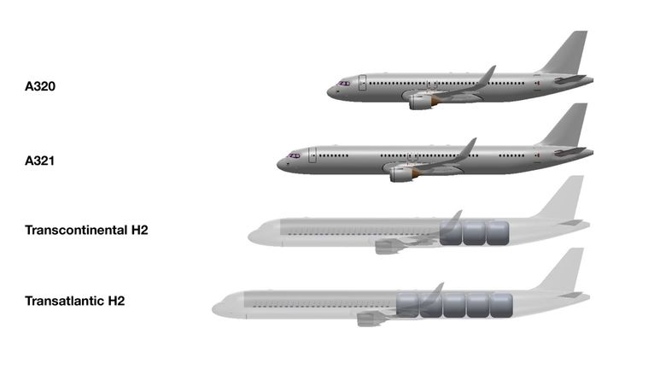
Aircraft Design| Impacts
Figure 12 – Illustration of future hydrogen powered flights
Gates, D. (2023, March 13). “pretty freakin” amazing’: Pioneering moses lake flight uses hydrogen to power regional airplane. The Seattle Times. https://www.seattletimes.com/business/boeing-aerospace/pioneering-moses-lake-flight-uses-hydrogen-to-power-regional-airplane/
Notes:
The end goal of increasing hydrogen in Jet fuel is to have 100% hydrogen fuel powered aircraft in the future.
With this in mind, there are a few design challenges that come with having hydrogen in an aircraft.
Since hydrogen has high volume to energy characteristics, aircraft would be required to carry a larger volume of fuel than they do now. This can be done in two ways:
Non-integral fuel tanks, which would be situated outside the aircraft either above the fuselage or on the wings, however they would need to be designed to cope with aerodynamic loads, and they must not increase drag – contribute to more fuel burn.

Slide 18

Conclusion

Slide 19
Conclusion
Best equivalence ratio case for implemented RQL
Primary zone – 1.5
Secondary zone – As low as possible (0.5)
NOx – 150 – 300 ppm
Trade off is required
Sensitivity Analysis – NOx and CO prediction
Hybrid techniques – Emissions control
Coupling RQL with EGR and MILD
Inhibiting reaction rates – Most sensitive equations
Photolytic Ions/Radicals Discharge
Future Scope :
Implementation of AI Models – PINN and ANN
Require large Datasets
Use of Optimization techniques and algorithms – Multidisciplinary Frameworks
Jointly analyze - LFV + ESR + IDT + Thermoacoustic Instabilities + Vibrations

Slide 20
References
S. Rondinelli, R. Sabatini, and A. G. M. Gardi, “Challenges and benefits offered by liquid hydrogen fuels in commercial aviation,” Proceedings of the Practical Responses to Climate Change 2014 (PRCC 2014), pp. 1–11, 2014.
K. Wang, R. Xu, T. Parise, J. Shao, A. Movaghar, D.J. Lee, J. Park, Y. Gao, T. Lu, F.N. Egolfopoulos, D.F. Davidson, R.K. Hanson, C.T. Bowman, H. Wang, A physics-based approach to modelling real-fuel combustion chemistry - IV. HyChem Modeling of Combustion Kinetics of a Bio-derived Jet Fuel and its Blends with a Conventional Jet A, Combustion and Flame 198 (2018) 477–489.
Y. Huang, C. Jiang, K. Wan, Z. Gao, L. Vervisch, P. Domingo, Y. He, Z. Wang, C.-H. Lee, Q. Cai, et al., “Prediction of ignition delay times of jet a-1/hydrogen fuel mixture using machine learning,” Aerospace Science and Technology, vol. 127, p. 107675, 2022.
Alabaş HA, Çeper BA. Effect of the hydrogen/kerosene blend on the combustion characteristics and pollutant emissions in a mini jet engine under CDC conditions. International Journal of Hydrogen Energy. 2023 May 30.

